Slide 1
ONAP Casablanca Use Case with HPA end to end
Haibin Huang, Intel SSG
ONAP Dublin Developer Forum, Pairs, Jan’9

Slide 2
Agenda
vCPE Overall
HPA registry and discovery
vCPE Design Time
vCPE Run Time

Slide 3
vCPE Overall

Slide 4
HPA Introduction
HPA is evolve from Enhanced Platform Awareness (EPA) HPA Provides awareness of underlying compute hardware platform capabilities to software running on the hardware platform.
HPA Used to optimize, accelerate or otherwise augment platform software execution
HPA feature including SRIOV NIC, PCI pass-through, Instruction Set extensions, huge page and so on.
In ONAP, HPA is used to optimize and accelerate virtual network function performance and throughput…
Today, we mainly introduce how to enable SRIOV-NIC in ONAP.
4
Notes:
OOM Private network

Slide 5

Environment at China Mobile Lab
WindRiver-openstack
Windriver-openstack
ONAP OAM Network
Switch
ONAP OAM Network
Controller-0
Controller-1
Controller-0
Controller-1
Management Network
Management Network
Compute0
Compute1
Compute2
Compute0
Compute1
Compute2
Data Network
5
Data Network
vCPE
vDHCP
vAAA
OS
OS
Casablanca
vBNG
vGMUX
vxxx
OS
OS
OS
5
5
Notes:
OOM Private network

Slide 6
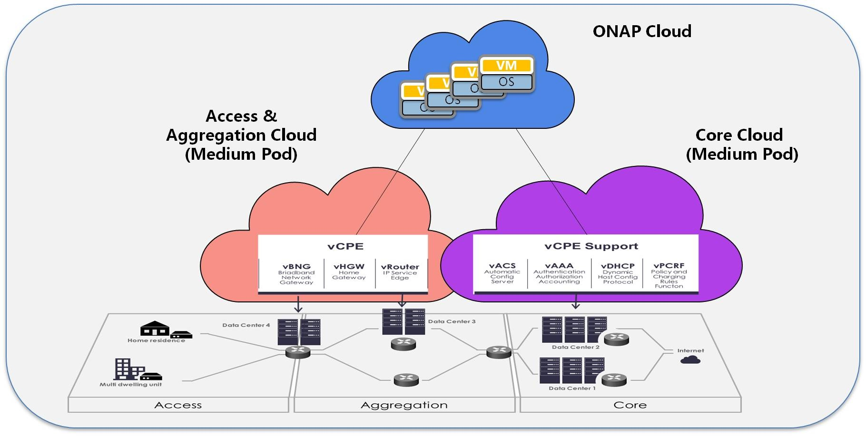
Use Case: vCPE
Notes:
VPP:

Slide 7
5 onboarding vnfs
infra: vDHCP, vAAA, vDNS, vWEB
vbrgemu: BRG Emulator(Bridged Residential Gateway Emulator)
vbng: VPP based Broadband Network Gateway
vgmux: VPP based Virtual Gateway Multiplexer
vgw: VPP based Virtual Gateway

Slide 8
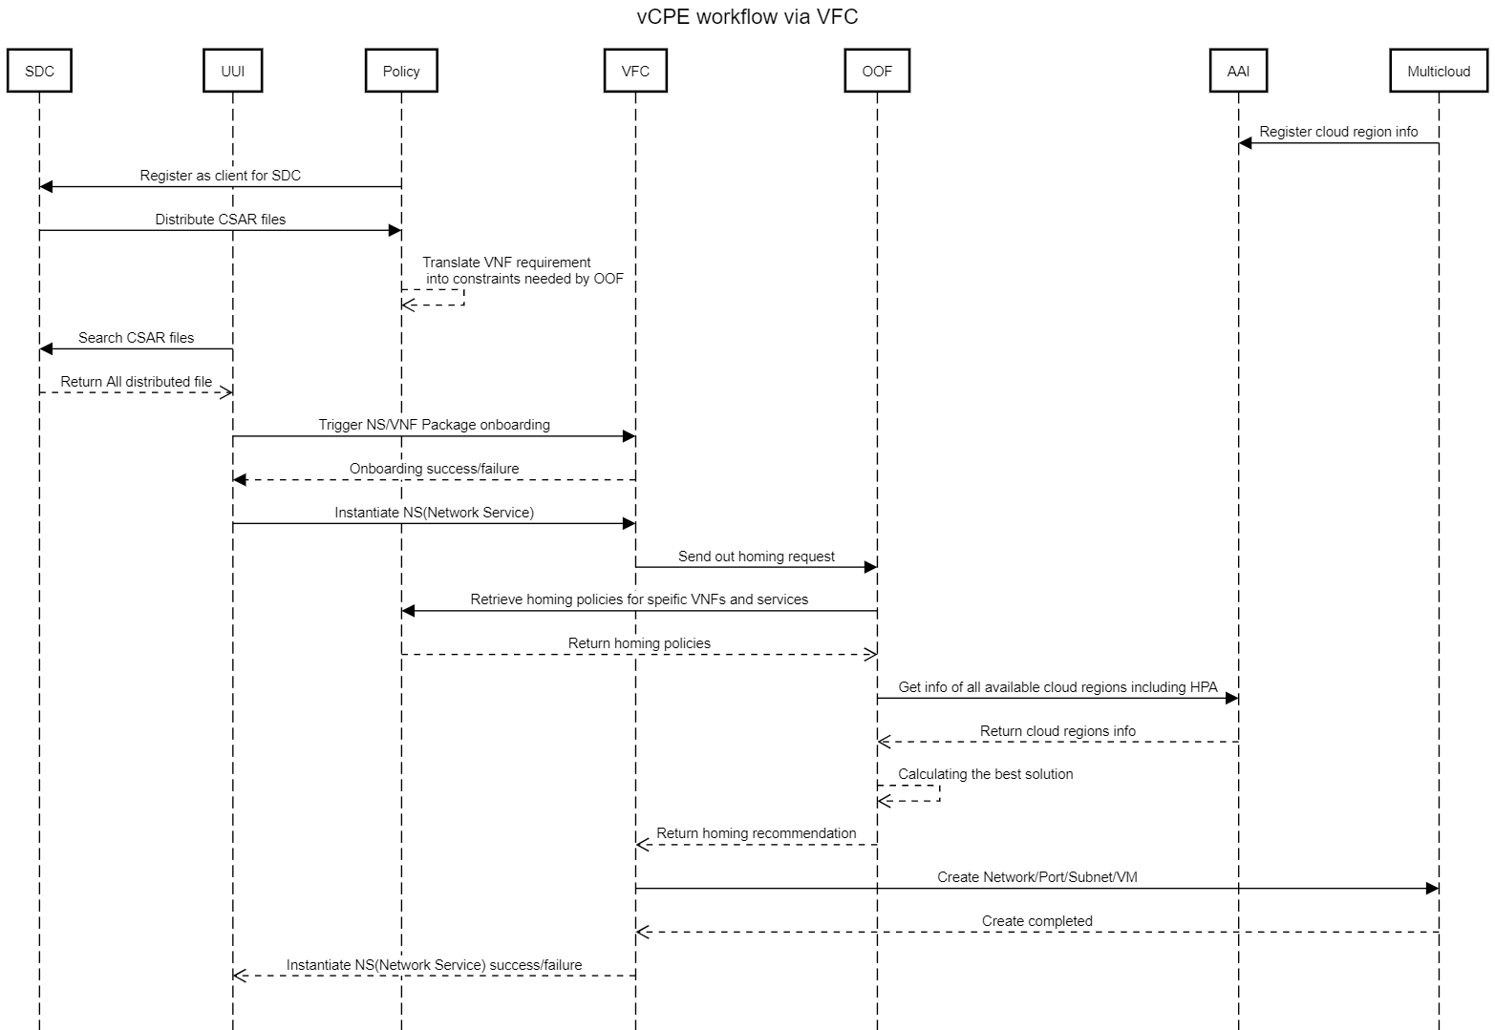
Design Time
Run Time
8
Notes:
title vCPE workflow via VFC
participant SDC
participant UUI
participant Policy
participant VFC
participant OOF
participant AAI
participant Multicloud
Multicloud->AAI: Register cloud region info
Policy->SDC: Register as client for SDC
SDC->Policy: Distribute CSAR files
Policy-->>Policy: Translate VNF requirement \n into constraints needed by OOF
UUI->SDC: Search CSAR files
SDC-->>UUI: Return All distributed file
UUI->VFC: Trigger NS/VNF Package onboarding
VFC-->UUI: Onboarding success/failure
UUI->VFC: Instantiate NS(Network Service)
VFC->OOF: Send out homing request
OOF->Policy: Retrieve homing policies for speific VNFs and services
Policy-->>OOF: Return homing policies
OOF->AAI: Get info of all available cloud regions including HPA
AAI-->>OOF: Return cloud regions info
OOF-->>OOF: Calculating the best solution
OOF-->>VFC: Return homing recommendation
VFC->Multicloud: Create Network/Port/Subnet/VM
Multicloud-->>VFC: Create completed
VFC-->>UUI: Instantiate NS(Network Service) success/failure

Slide 9
HPA registry and discovery

Slide 10
VIM configure
NIC configure
We can refer to link before “Launching instances with SR-IOV ports”
pci_passthrough_whitelist = { "devname": "eth3", "physical_network": "physnet2"}
Create aggregate
$ openstack aggregate create --property sriov_nic=sriov-nic-intel-1234-5678-physnet1:1 aggr11
Create flavor
$ openstack flavor create onap.flavor1 --id auto --ram 512 --disk 40 --vcpus 4
$ openstack flavor set onap.flavor1 --property sriov_nic=sriov-nic-intel-1234-5678-physnet1:1
Create provider network
10

Slide 11
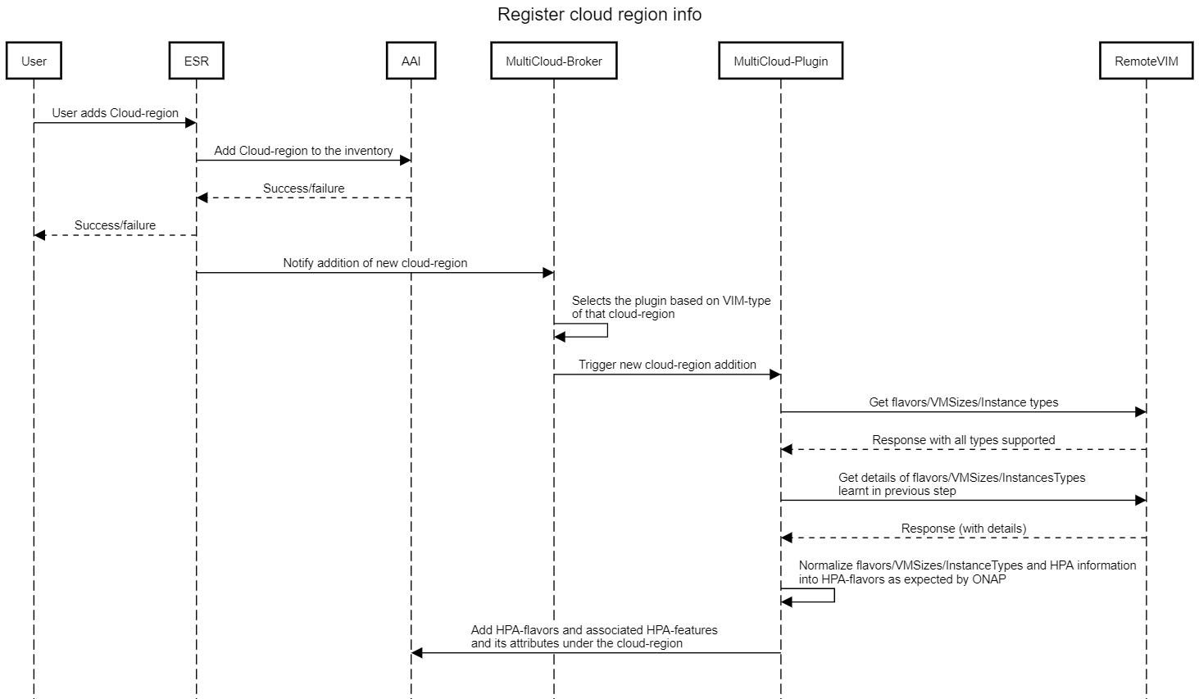
HPA registry and discovery
11
Notes:
https://sequencediagram.org/index.html
title Register cloud region info
participant User
participant ESR
participant AAI
participant MultiCloud-Broker
participant MultiCloud-Plugin
participant RemoteVIM
User->ESR: User adds Cloud-region
ESR->AAI: Add Cloud-region to the inventory
ESR<--AAI : Success/failure
User<--ESR: Success/failure
ESR->MultiCloud-Broker: Notify addition of new cloud-region
MultiCloud-Broker->MultiCloud-Broker: Selects the plugin based on VIM-type \nof that cloud-region
MultiCloud-Broker->MultiCloud-Plugin: Trigger new cloud-region addition
MultiCloud-Plugin->RemoteVIM: Get flavors/VMSizes/Instance types
MultiCloud-Plugin<--RemoteVIM: Response with all types supported
MultiCloud-Plugin->RemoteVIM: Get details of flavors/VMSizes/InstancesTypes \nlearnt in previous step
MultiCloud-Plugin<--RemoteVIM: Response (with details)
MultiCloud-Plugin->MultiCloud-Plugin: Normalize flavors/VMSizes/InstanceTypes and HPA information \ninto HPA-flavors as expected by ONAP
MultiCloud-Plugin->AAI: Add HPA-flavors and associated HPA-features \nand its attributes under the cloud-region

Slide 12
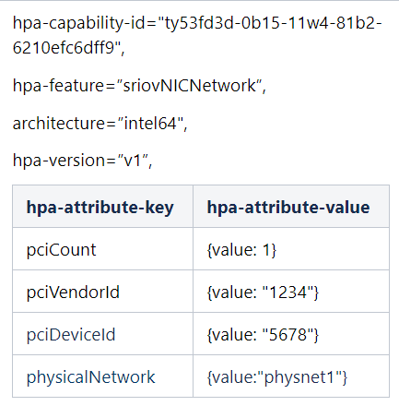
HPA registry and discovery
sriov_nic=sriov-nic-<vendor>-<Vendor ID>-<Device ID>-<physicalNetwork:COUNT>
It is expected thatOpenstackadministrator creates alias that stars with sriov and put the vendor ID, device ID.
Examples:
Assume that there are two SRIOV-NIC cards supported by a region, Intel and Mellanox.
sriov-nic-intel-1234-5678-physnet1:1
sriov-nic-mellanox-2345-6543-physnet1:1
12
Notes:
https://sequencediagram.org/index.html
title Register cloud region info
participant User
participant ESR
participant AAI
participant MultiCloud-Broker
participant MultiCloud-Plugin
participant RemoteVIM
User->ESR: User adds Cloud-region
ESR->AAI: Add Cloud-region to the inventory
ESR<--AAI : Success/failure
User<--ESR: Success/failure
ESR->MultiCloud-Broker: Notify addition of new cloud-region
MultiCloud-Broker->MultiCloud-Broker: Selects the plugin based on VIM-type \nof that cloud-region
MultiCloud-Broker->MultiCloud-Plugin: Trigger new cloud-region addition
MultiCloud-Plugin->RemoteVIM: Get flavors/VMSizes/Instance types
MultiCloud-Plugin<--RemoteVIM: Response with all types supported
MultiCloud-Plugin->RemoteVIM: Get details of flavors/VMSizes/InstancesTypes \nlearnt in previous step
MultiCloud-Plugin<--RemoteVIM: Response (with details)
MultiCloud-Plugin->MultiCloud-Plugin: Normalize flavors/VMSizes/InstanceTypes and HPA information \ninto HPA-flavors as expected by ONAP
MultiCloud-Plugin->AAI: Add HPA-flavors and associated HPA-features \nand its attributes under the cloud-region

Slide 13
vCPE Design Time
13

Slide 14
HPA TOSCA Description
We can get TOSCA format vCPE VNF from link and
Get TOSCA format HPA from link
Cp_vgw_mux_gw_private_net:
type: tosca.nodes.nfv.VduCp
properties:
layer_protocol: [ipv4]
trunk_mode: false
protocol_data:
……
vnic_type: "direct"
virtual_network_interface_requirements:
- name: "sriov-support"
support_mandatory: true
network_interface_requirements:
interfaceType: '{"schemaVersion": "0", "schemaSelector": "",
"hardwarePlatform": "generic", "mandatory": "true", "configurationValue": "SR-IOV"}'
nic_io_requirements:
logical_node_requirements:
pciVendorId: '{"schemaVersion": "0", "schemaSelector": "",
"hardwarePlatform": "generic","mandatory": "true", "configurationValue": "1234"}'
pciDeviceId: '{"schemaVersion": "0", "schemaSelector": "",
"hardwarePlatform": "generic","mandatory": "true", "configurationValue": "5678"}'
pciNumDevices: '{"schemaVersion": "0", "schemaSelector": "",
"hardwarePlatform": "generic", "mandatory": "true", "configurationValue": "1"}'
requirements:
- virtual_binding: VDU_vgw_0
- virtual_link: VL_mux_gw_private_net
VL_mux_gw_private_net:
type: tosca.nodes.nfv.VnfVirtualLink
properties:
connectivity_type:
layer_protocol: ipv4
vl_profile:
max_bit_rate_requirements:
root: 10000000
leaf: 10000000
min_bit_rate_requirements:
root: 10000000
leaf: 10000000
networkName: { get_input: mux_gw_private_net_id}
cidr: { get_input: mux_gw_private_net_cidr }
dhcpEnabled: false
physicalNetwork: "physnet1"

Slide 15
ONAP Design Time – VNF Onboarding
Upload descriptive model of the virtual function (TOSCA) including VNF package which is wrote and comply to ETSI SOL001.
Validate, assign, license, certify virtual function
SDC will generate new VNF with new format which is not fully comply to ETSI SOL001
SDC
VNFs Package
Onboarding

Slide 16
ONAP Design Time – Service Distribute
"flavorLabel":"vcpe.vgw",
"flavorProperties":[{
"hpa-feature": "sriovNICNetwork",
"mandatory": "True",
"architecture": "generic",
"hpa-version": "v1",
"directives" : [
{
"type": "sriovNICNetwork_directives",
"attributes": [
{"attribute_name": "vgw_nic_type", "attribute_value": “direct"},
{"attribute_name": "vgw_provider_network", "attribute_value": “physnet1"}
]
}
],
"hpa-feature-attributes": [
{
"hpa-attribute-key": "pciVendorId",
"hpa-attribute-value": "1234", "operator": "=", "unit": ""
},
{
"hpa-attribute-key": "pciDeviceId",
"hpa-attribute-value": "5678", "operator": "=", "unit": ""
},
{
"hpa-attribute-key": "pciCount",
"hpa-attribute-value": "1", "operator": ">=", "unit": ""
},
{
"hpa-attribute-key": "physicalNetwork",
"hpa-attribute-value": "physnet1", "operator": "=", "unit": "“
}
]
},
]
Policy will parse the VNF and get policy.
SDC
vCPE Service Package
SO
Policy

Slide 17
vCPE Run Time
17

Slide 18
ONAP Run Time
VFC Lifecycle: instantiate/terminate/heal…
OOF
3
Policy
2
1
4
5
WindRiver
(Openstack)
UUI
VF-C
Multi-Cloud

Slide 19
Policy
Customer
Input
"flavorLabel":"vcpe.vgw",
"flavorProperties":[{
"hpa-feature": "sriovNICNetwork",
"mandatory": "True",
"architecture": "generic",
"hpa-version": "v1",
"directives" : [
{
"type": "sriovNICNetwork_directives",
"attributes": [
{"attribute_name": "vgw_nic_type", "attribute_value": “direct"},
{"attribute_name": "vgw_provider_network", "attribute_value": “physnet1"}
]
}
],
"hpa-feature-attributes": [
{
"hpa-attribute-key": "pciVendorId",
"hpa-attribute-value": "1234", "operator": "=", "unit": ""
},
{
"hpa-attribute-key": "pciDeviceId",
"hpa-attribute-value": "5678", "operator": "=", "unit": ""
},
{
"hpa-attribute-key": "pciCount",
"hpa-attribute-value": "1", "operator": ">=", "unit": ""
},
{
"hpa-attribute-key": "physicalNetwork",
"hpa-attribute-value": "physnet1", "operator": "=", "unit": "“
}
]
},
]
REST APIs
Policy
Policy Driven Decision & Enforcement Framework
Policy Creation
Administration
Policy DB
REST APIs/Event Driven
Policy Distribution
OOF
SDC

Slide 20
OOF Homing
OOF: ONAP Optimization Framework
OSDF: Optimization Service Design Framework
HAS: Homing Allocation Service
VFC
①
Policy
VFC sends out homing request to OOF(OSDF) containing resource info
OOF(OSDF) pulls all the related homing constraints from Policy
OOF(HAS) check AAI database to pull region(flavor) information
OOF(OSDF) returns homing allocation solution to VFC
②
OOF- OSDF
④
OOF - HAS
③
AAI

Slide 21
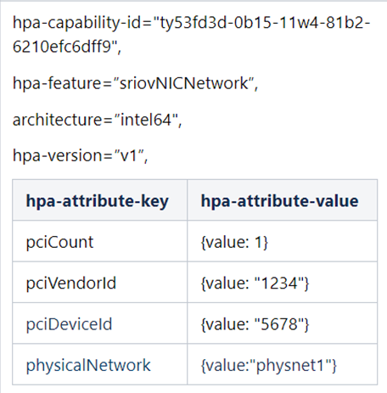
OOF Homing
"flavorLabel":"vcpe.vgw",
"flavorProperties":[{
"hpa-feature": "sriovNICNetwork",
"mandatory": "True",
"architecture": "generic",
"hpa-version": "v1",
"directives" : [
{
"type": "sriovNICNetwork_directives",
"attributes": [
{"attribute_name": "vgw_vnic_type", "attribute_value": "direct"},
{"attribute_name": "vgw_provider_network", "attribute_value": "physnet1"}
]
}
],
"hpa-feature-attributes": [
{
"hpa-attribute-key": "pciVendorId",
"hpa-attribute-value": "1234", "operator": "=", "unit": ""
},
{
"hpa-attribute-key": "pciDeviceId",
"hpa-attribute-value": "5678", "operator": "=", "unit": ""
},
{
"hpa-attribute-key": "pciCount",
"hpa-attribute-value": "1", "operator": ">=", "unit": ""
},
{
"hpa-attribute-key": "physicalNetwork",
"hpa-attribute-value": "physnet1", "operator": "=", "unit": "“
}
]
},
]
AAI
Policy

Slide 22
VFC Create network and port
"type": "sriovNICNetwork_directives",
"attributes": [
{"attribute_name": “vgw_vnic_type", "attribute_value": "direct"},
{"attribute_name": “vgw_provider_network", "attribute_value": "physnet1"}
Create network, ports
# openstack network create --provider-network-type vlan --provider-physical-network physnet1 tst-network
# openstack port create --name sriov-port --binding:vnic-type direct
b. Create server
# openstack server create --flavor onap.hpa.flavor11 --image Ubuntu_16.04 --nic port-id= test-sriov-nic

Slide 23
Demo Time

Slide 24
Thank You

Slide 25
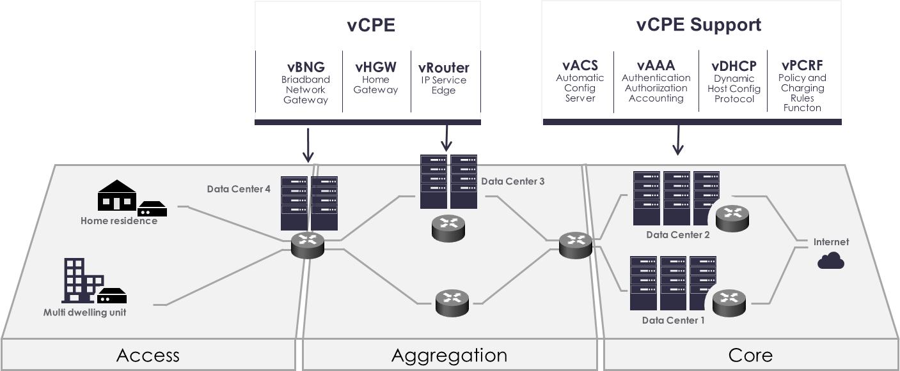
Edge Use Case: vCPE
Virtual customer premises equipment (vCPE) is a way to deliver network services such as routing, firewall security and virtual private network connectivity to enterprises by using software rather than dedicated hardware devices.

Slide 26
Use Case: vCPE
DCAE
(Collector)
DMaaP
SDNC
Control
Infrastructure
ONAP OAM Neutron Network
Data + Control
Per Customer
vDHCP
Dynamic Host Config Protocol
vAAA
Authorization, Authentication, Accounting
vDNS + vPDHCP
Home Network 1
BRG
Emulator 1 (VPP)
vG1
(VPP)
vBNG
(VPP)
vG MUX
(VPP)
CPE Public Neutron Network
Web Server
Home Network 2
BRG
Emulator 2
(VPP)
vG2
(VPP)
Notes:
VPP:

